Slide 1
Take Home Test
Sales Performance & Shopping Behavior Analytics

Slide 2
01 / PROBLEM STATEMENT
The Core Business Challenge
Deploy targeted promotions precisely when and where customers are most active and focusing ad placements on high value tech categories and peak shopping hours

Slide 3
01 / DATASET OVERVIEW
Dataset Scope & Schema
2,090
401
Activity Logs
Unique Users
Column Name | Data Type | Business Context
User_id / Session_id | String | Unique customer and session identifiers
DateTime | DateTime | Activity timestamp (Jan 1 – Dec 22, 2019)
Category / SubCategory | String | Product (e.g., Tablets → iPad)
Action | String | 10 user actions from search to purchase
Quantity / Rate / Total Price | Int / Float | Populated on 201 completed purchase rows

Slide 4



01 / OBJECTIVES
Analysis Goals
Behavioral Trends
Revenue Drivers
Actionable Strategy
Map activity across hours and weekdays.
Pinpoint top earning product categories.
Guide inventory and campaign timing.

Slide 5
02 / DATA PREPROCESSING
Data Cleaning Workflow in Google Colab
01
02
03
04
Zero Imputation
Typo Resolution
Time Features
Outlier Flagging
Filled 1,889 non-purchase rows with zero.
Unified 10 actions across 102 categories.
Extracted Date, Month, DayOfWeek, Hour.
Tagged 29 orders above 18,500 IQR bound.

Slide 6
03 / EXPLORATORY DATA ANALYSIS
Dataset & Executive KPIs
1.90M
401
596
9,455
Total Revenue
Unique Users
Items Sold
Purchase AOV
Displayed as 2M on BI Card
Across 2,090 log events
From 201 completed orders
909.34 across all sessions

Slide 7
03 / EXPLORATORY DATA ANALYSIS
Normal vs. High Value Order Comparison
Normal Orders (≤ 18,500)
High-Value Outliers (> 18,500)
Order Volume: 172 transactions (85.6% share).
Order Volume: 29 transactions (14.4% share).
Total Revenue: 612,130 (32.2% share).
Total Revenue: 1,288,400 (67.8% share).
Segment Mean: 3,559 per transaction.
Segment Mean: 44,428 per transaction.
Overall Median: 2,500 across all purchases.
Max Purchase: 160,000 (2 units of iPad).

Slide 8
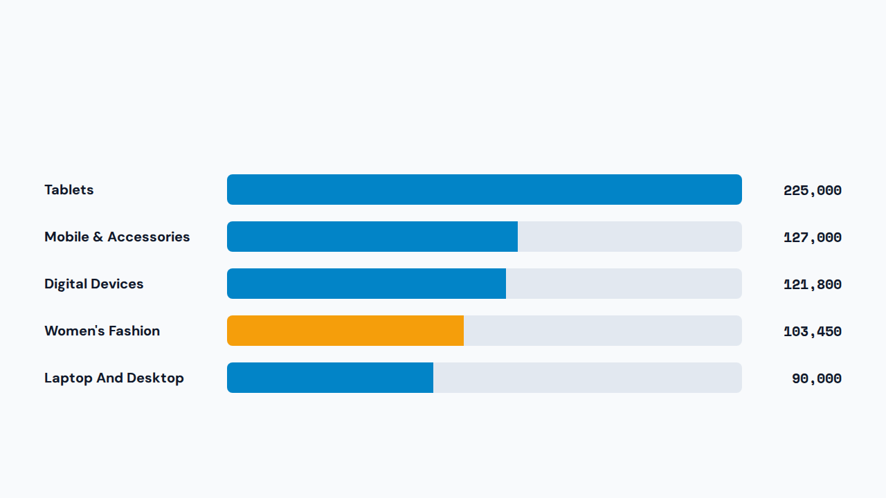
03 / EXPLORATORY DATA ANALYSIS
Top 5 Product Categories by Revenue

Slide 9
04 / INSIGHTS & INTERPRETATION
Peak Transaction Windows
14:00 Early Afternoon Surge
PRIMARY PEAK HOUR
Generates 232,250 as momentum builds.
15:00
19:00 Evening Rebound
Second major spike reaching 301,300 post-work.
412,950 Total Revenue
21:00 Nighttime Wave
Highest afternoon checkout surge.
Late browsing session contributing 190,910.

Slide 10
04 / INSIGHTS & INTERPRETATION
User Action & Weekly Traffic Breakdown
User Action Type | Sessions | Day of Week | User Activity Count
read_reviews | 365 | Monday (Peak) | 536
search | 320 | Wednesday | 356
product_view | 292 | Thursday | 341
add_to_cart | 280 | Friday | 275
checkout / wishlist | 202 each | Tuesday / Sunday | 231 / 209
purchase | 201 | Saturday (Lowest) | 142

Slide 11

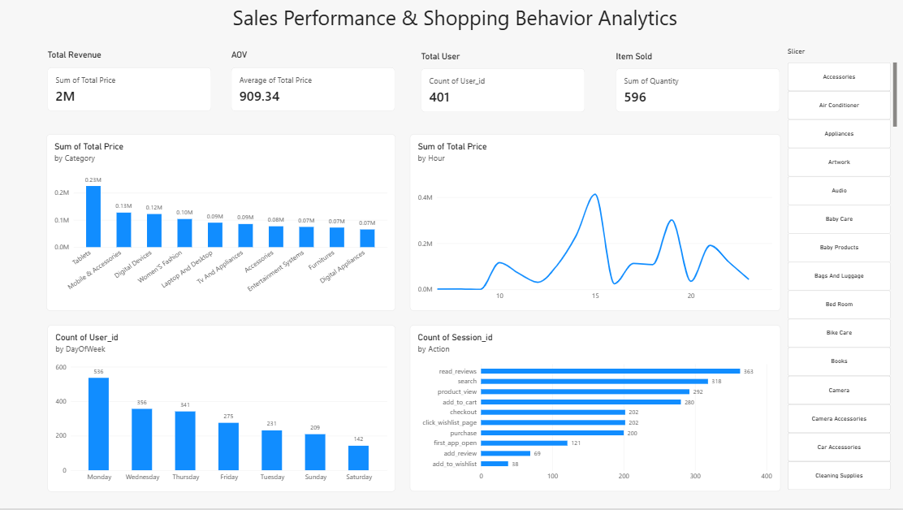
05 / DASHBOARD IMPLEMENTATION
Interactive Power BI Executive Dashboard
4 KPI Scorecards
Instant snapshot of Revenue, AOV, Users, Items.
4 Core Visuals
Category revenue, hourly trend, weekday traffic, actions.
Category Slicer
Dynamic drill down across all 102 product categories.

Slide 12
Documentation
Documentation
Colab
https://colab.research.google.com/drive/1vrwaO7pj2wUhBHDFumh0hdNKo4Om43tp?usp=sharing

Slide 13
Thank You

